Slide 1
Project Name : MANUFACTURINg analytics
Group Members
AYUSH PAul
ANNIKET RAJ
DIVYA KRISHNA RAO
TENZING NORPHEL BHTIA
HARSHITA
Rahul Krishna Salve
Priyadarshini N J

Slide 2
Overview of the Manufacturing Industry: The manufacturing industry involves the large-scale production of goods through various stages such as material sourcing, production, quality control, and distribution. It operates globally, supporting multiple sectors with a focus on efficiency, innovation, and meeting dynamic consumer and industrial demands.
Purpose of the Project: The purpose of this project is to optimize manufacturing processes through data-driven analysis, aiming to enhance operational efficiency, reduce wastage, improve product quality, and support sustainable and profitable growth within the manufacturing sector.
Objective:
To monitor, analyze, and improve the manufacturing process by tracking key production and quality metrics such as manufactured quantity, rejected quantity, processed quantity, and wastage percentage, etc.
Goal:
The goal is to enable data-driven decisions that optimize manufacturing efficiency, reduce rejection rates, and minimize wastage.

Slide 3
Problem statement: 1 Manufacture Qty. 2 rejected Qty. 3 Processed qty. 4 wastage qty. 5 employee wise rejected qty. 6 machine wise rejected qty. 7 production comparison trend. 8 manufacture Vs rejected. 9 department wise manufacture vs rejected. 10 emp wise rejected qty.

Slide 4
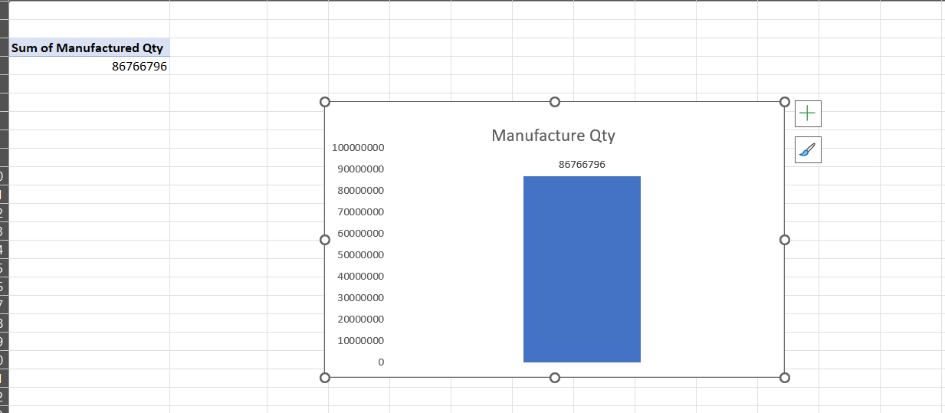
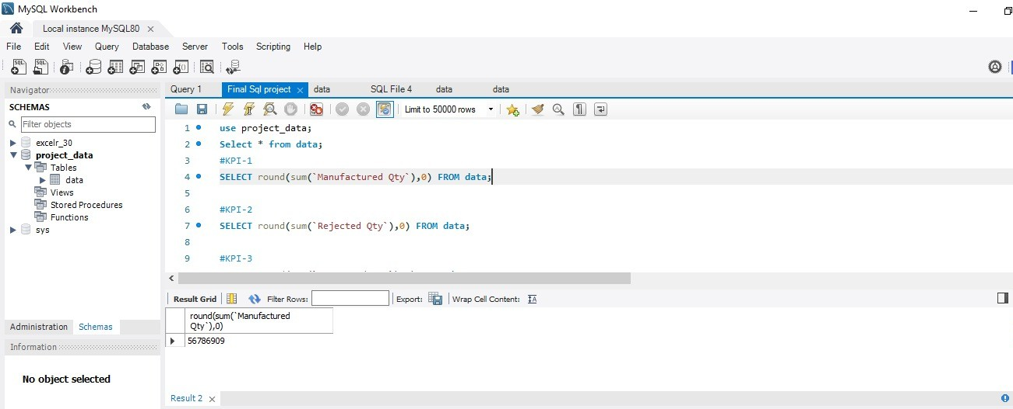
KPI 1: Manufacturing Qty
This KPI is to find out the Manufacture Qty
From this data we get to know that the sum of manufacturing Qty is 87 M

Slide 5
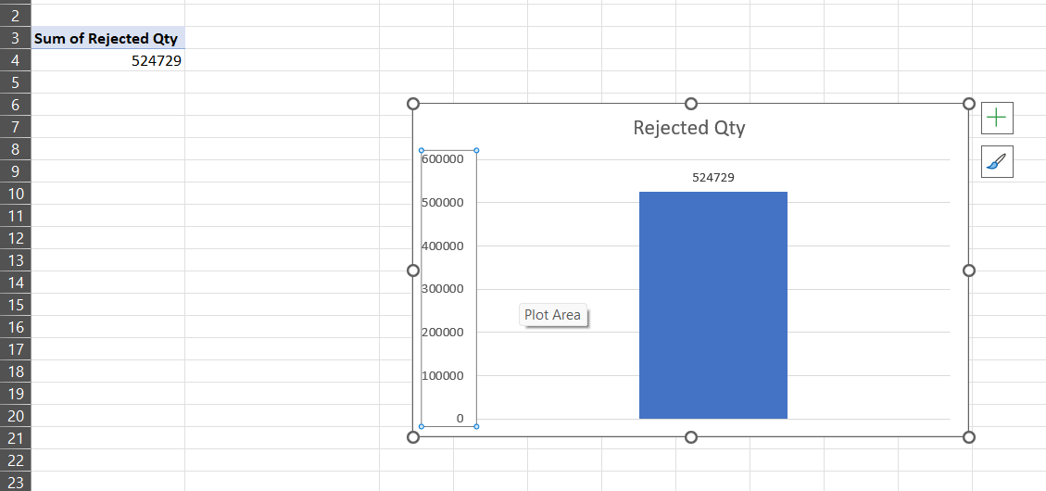
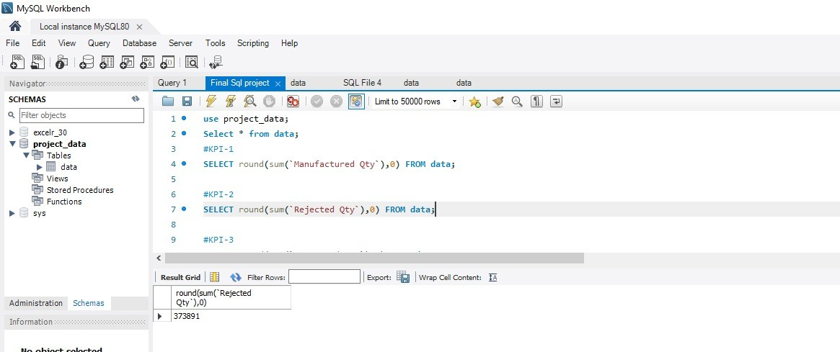
KPI 2 Rejected qty
This KPI is to find out the Rejected Qty
From this data we get to know that the sum of Rejected Qty is 525K

Slide 6
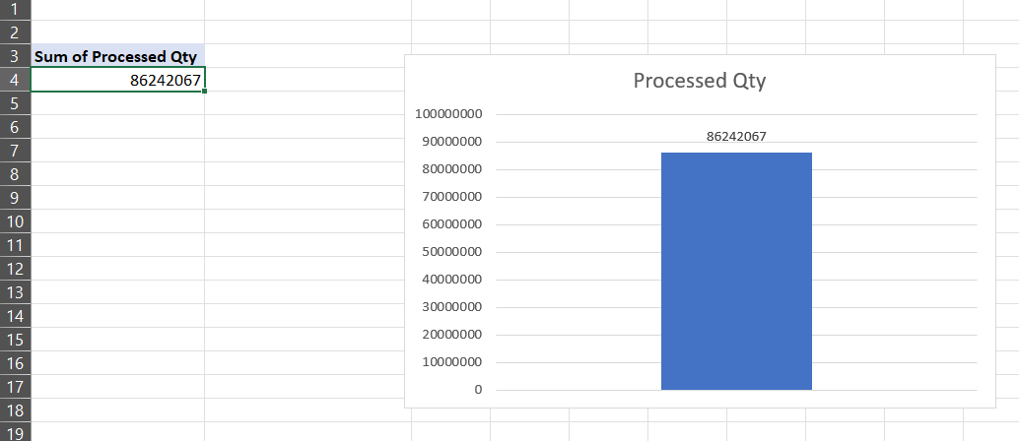
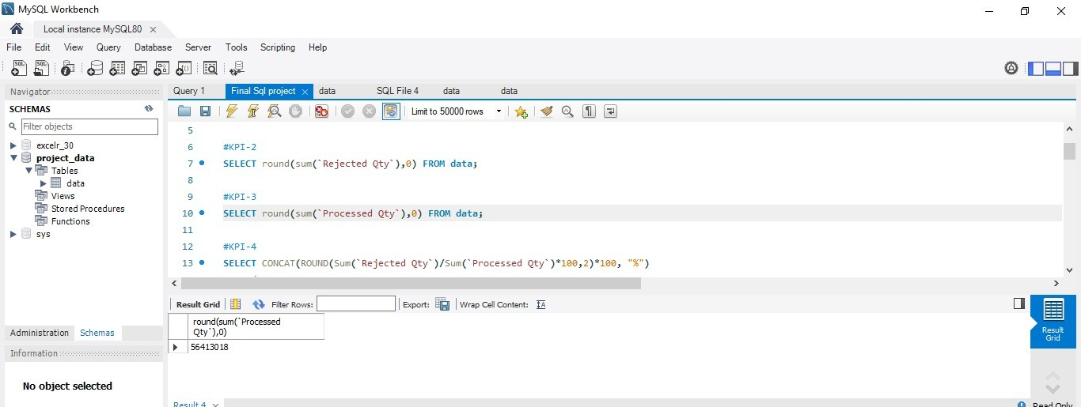
KPI 3 Processed qty
This KPI is to find out the Processed Qty
From this data we get to know that the sum of Processed Qty is 86 M

Slide 7
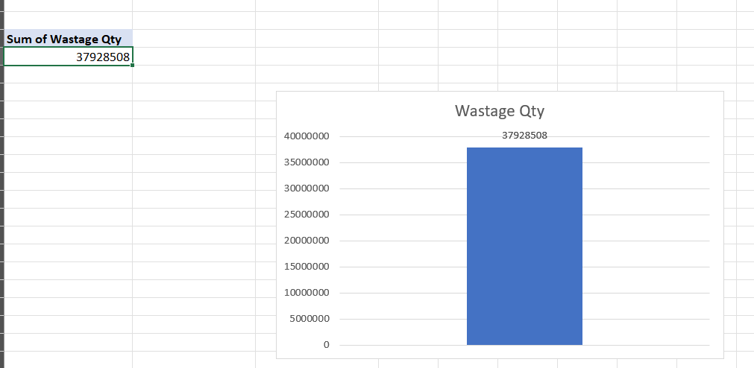
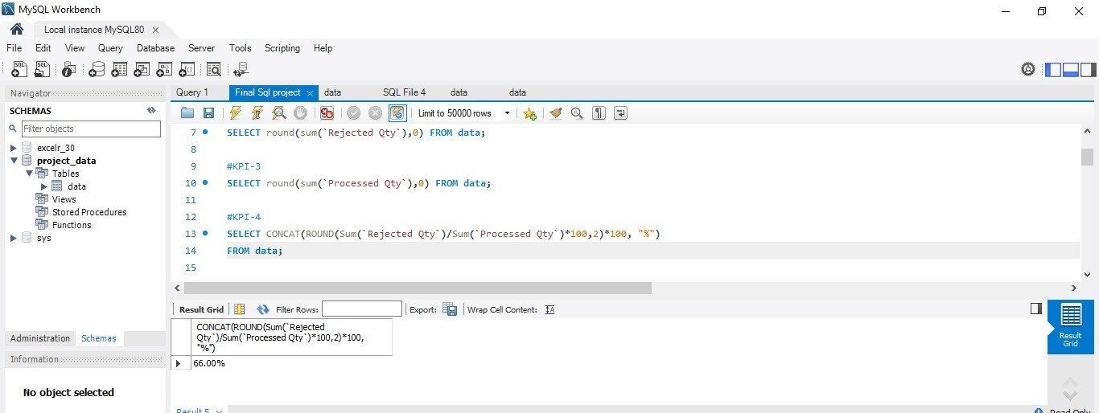
kpi 4 wastage qty
This KPI is to find out the Wastage Qty
From this data we get to know that the sum of Wastage Qty is 37 M

Slide 8
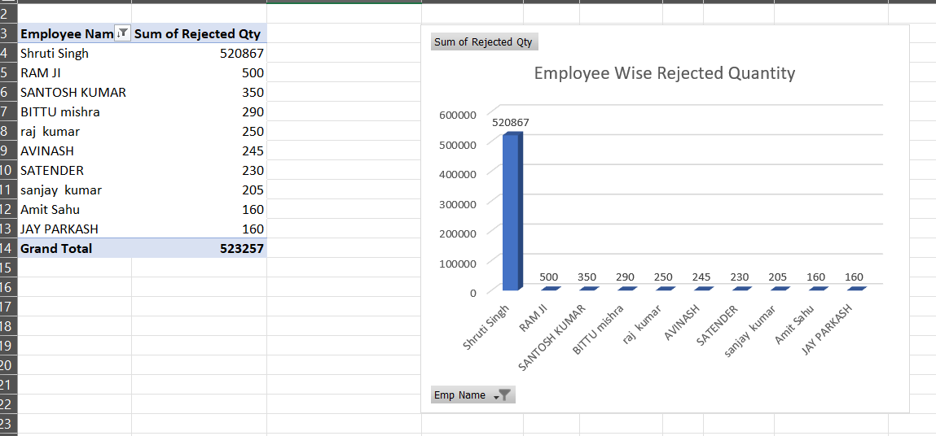
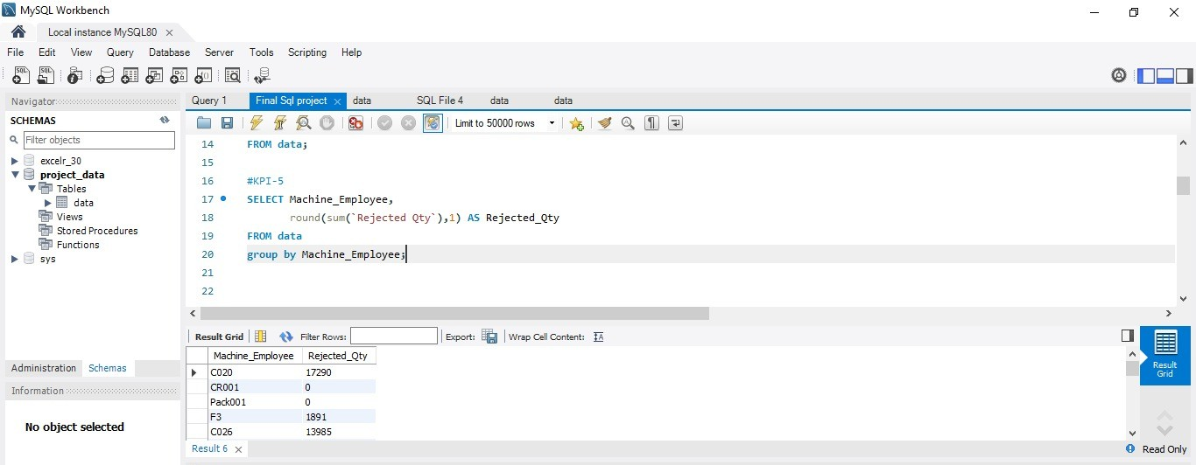
Kpi 5 employee wise rejected qty
This KPI is to find out the Employee wise Rejected Qty
From this data we get to know that the Shruti Singh, Ram ji and Santosh kumar are the highest 3 employees who makes Rejected product while manufacturing.

Slide 9
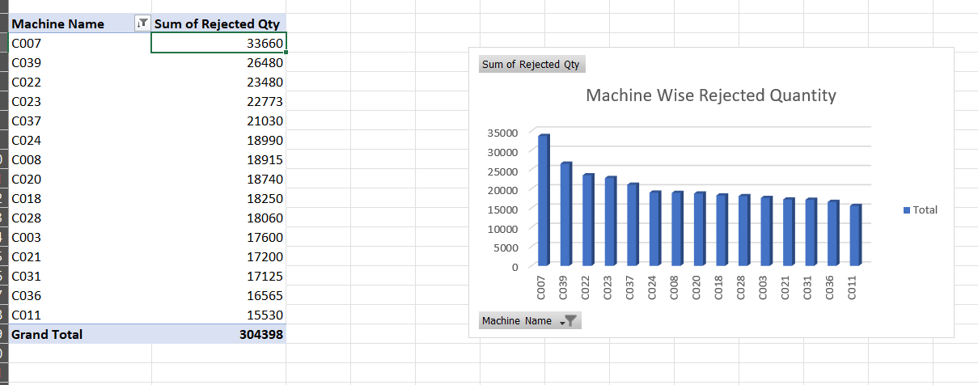
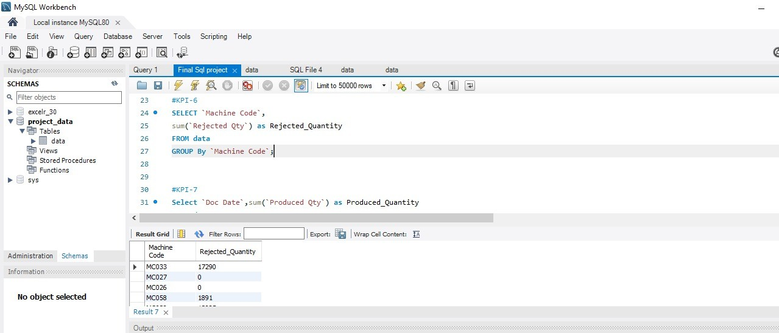
Kpi 6 machine wise rejected qty
This KPI is to find out the Machine wise Rejected Qty
From this data we get to know that the C007, C039 and C022 are the highest 3 Machines who makes Rejected product while manufacturing.

Slide 10
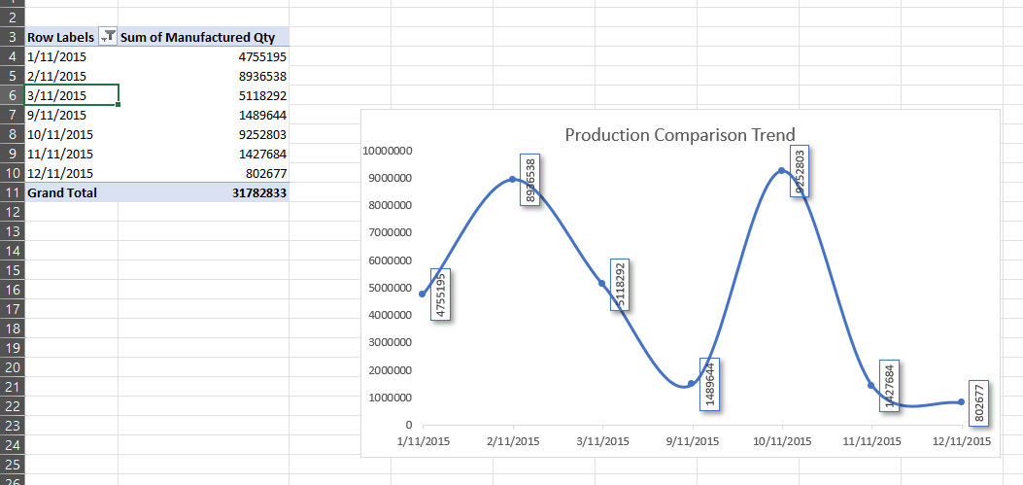
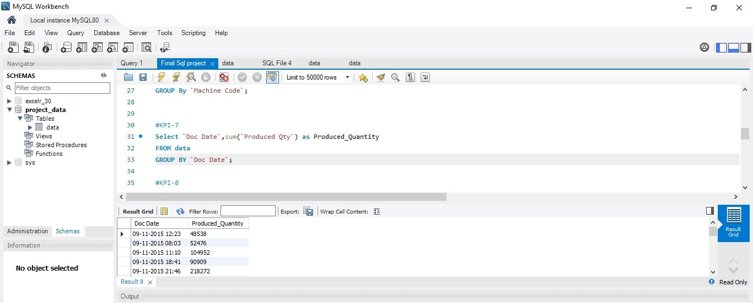
Kpi 7 Production comparison trend
This KPI is to find out the Production Comparison Trend
From this kpi we will see the trend as per the chart shown in image.

Slide 11
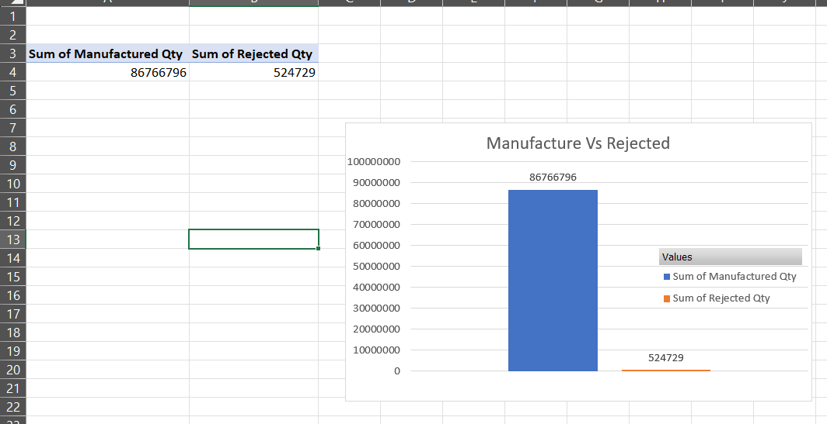
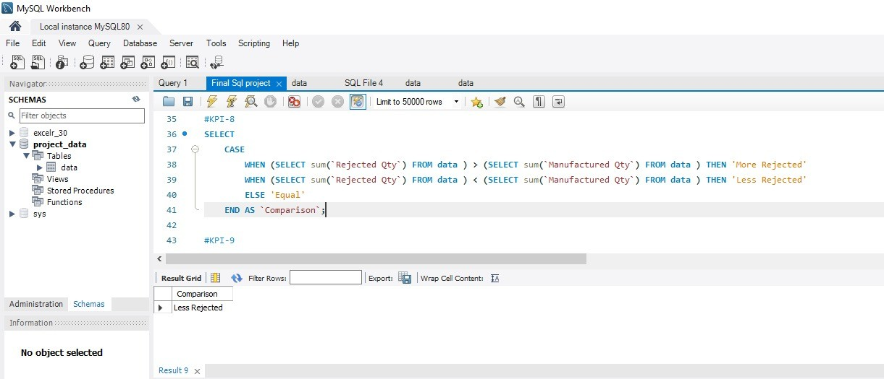
Kpi 8 Manufacture vs rejected
This KPI is to find out the Manufacture Qty Vs Rejected Qty
From this data we get to know that the Sum of Manufactured Qty is 87M Vs the Sum of Rejected Qty is 525K.

Slide 12
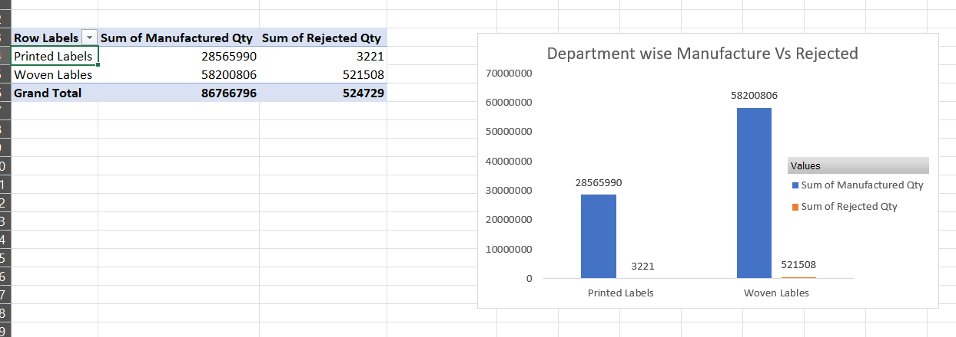
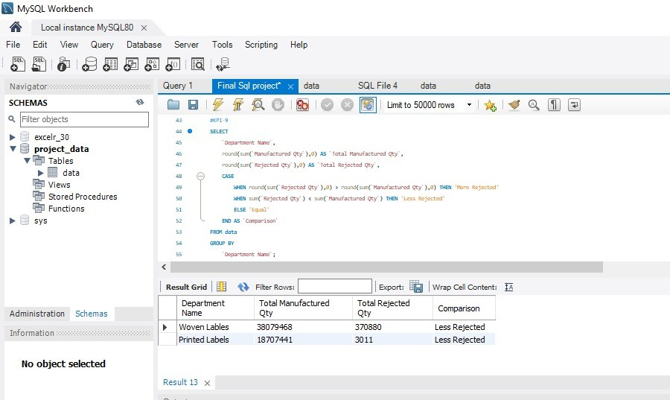
Kpi 9 department wise manufactured vs rejected
This KPI is to find out the Department wise manufactured Vs Rejected
From this chart we will get that the Printed labels Manufactured Qty is 28M Vs Rejected is 3221 Whereas For Woven labels Manufactured Qty is 58M Vs Rejected is 5 Lakh.

Slide 13
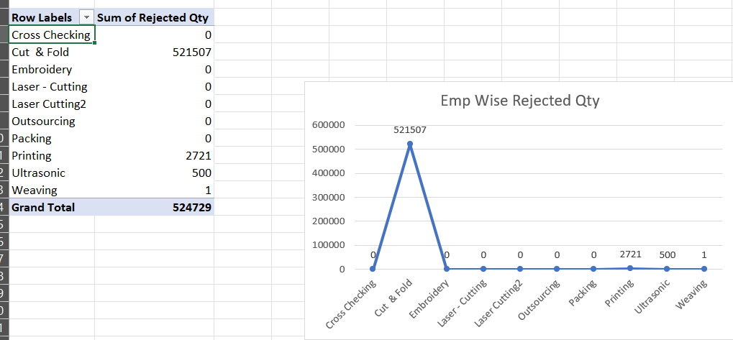
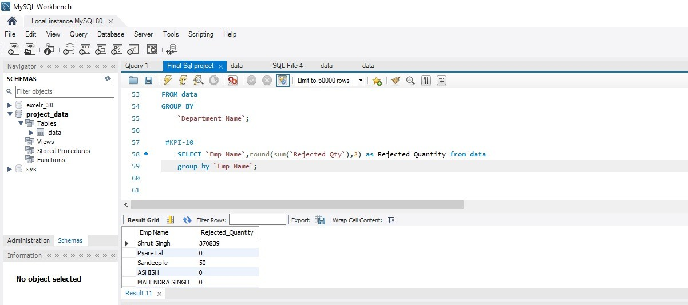
Kpi 10 emp wise rejected qty
This KPI is to find out the Emp wise Rejected Qty
From this we can guide targeted improvement to enhance operational efficiency and product quality

Slide 14
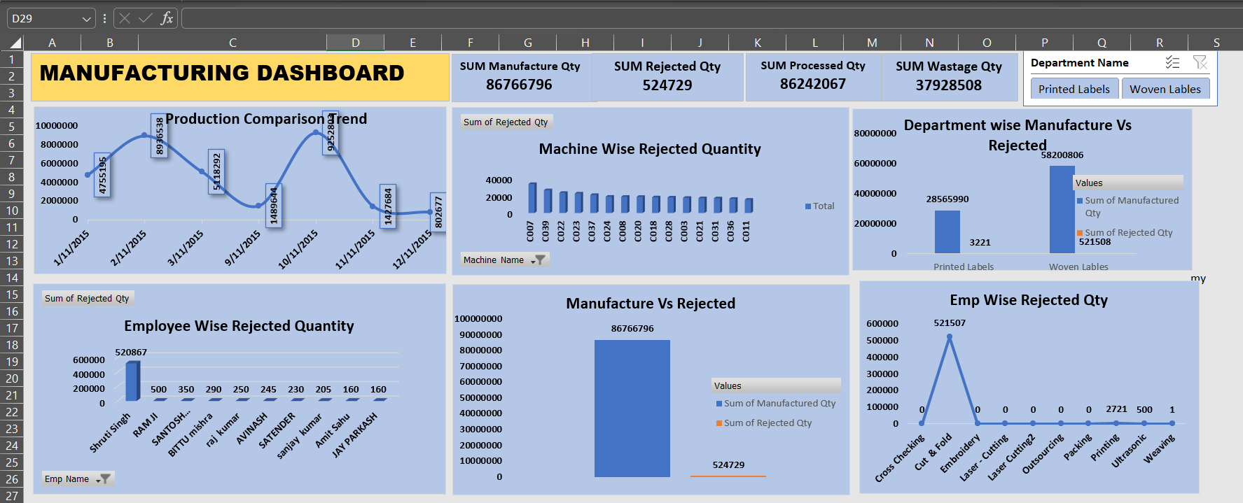
EXCEL DASHBOARD

Slide 15
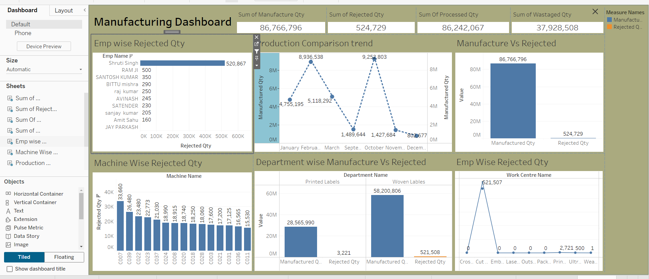
TABLUE DASHBOARD

Slide 16
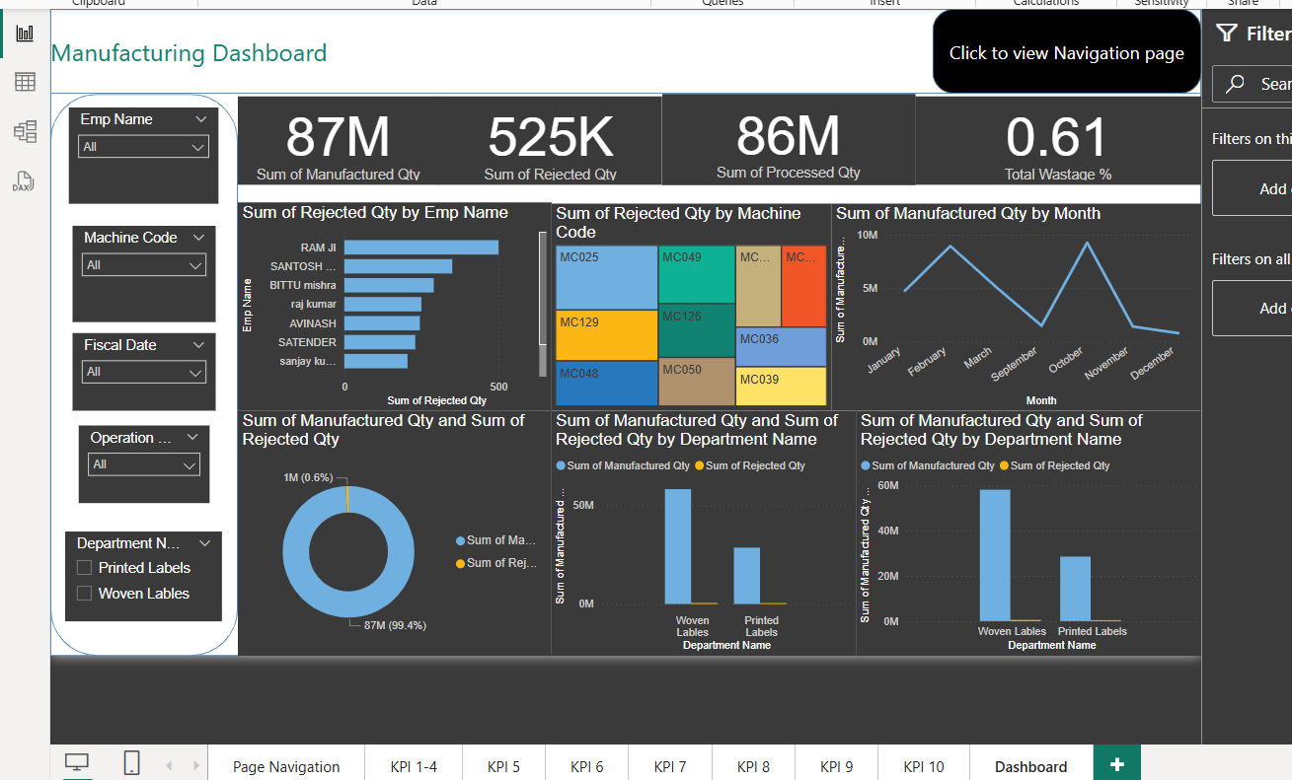
POWERBI DASHBOARD

Slide 17
Conclusion: Improving Efficiency and Quality in Manufacturing operations
Manufacturing Quantity: Keeping track of how much we produce helps us plan better and make sure we meet customer demand without wasting resources.
Rejected Quantity: Looking at the number of rejected items shows us where quality problems are happening, so we can fix them, reduce waste, and make customers happier.
Processed Quantity: Measuring how much gets successfully processed tells us how efficient our production is and where we can speed things up.
Wastage Quantity: Knowing how much material gets wasted helps us find areas to save costs and use materials more wisely.
Employee-Wise Rejected Quantity: Checking which employees have more rejected products helps us spot training needs and improve individual performances, which reduces overall defects.

Slide 18
Machine-Wise Rejected Quantity: Tracking how much each machine rejects helps us plan maintenance better, fix issues quickly, and keep machines running smoothly with fewer mistakes.
Production Comparison Trend: By comparing production trends over time, we can adjust our work schedules and resources early to meet changes in customer demand.
Manufactured vs Rejected: Looking at how much was made versus how much was rejected shows the overall quality of production and helps us find ways to reduce errors.
Department-Wise Manufactured vs Rejected: Comparing production and rejections across departments shows which departments are doing better or need help, so we can focus our improvement efforts.
Operation-Wise Rejected Quantity: Finding out which operations (like cutting, sewing, printing) have more rejections helps us fix specific problems and make the whole process faster and better.

